Slide 1
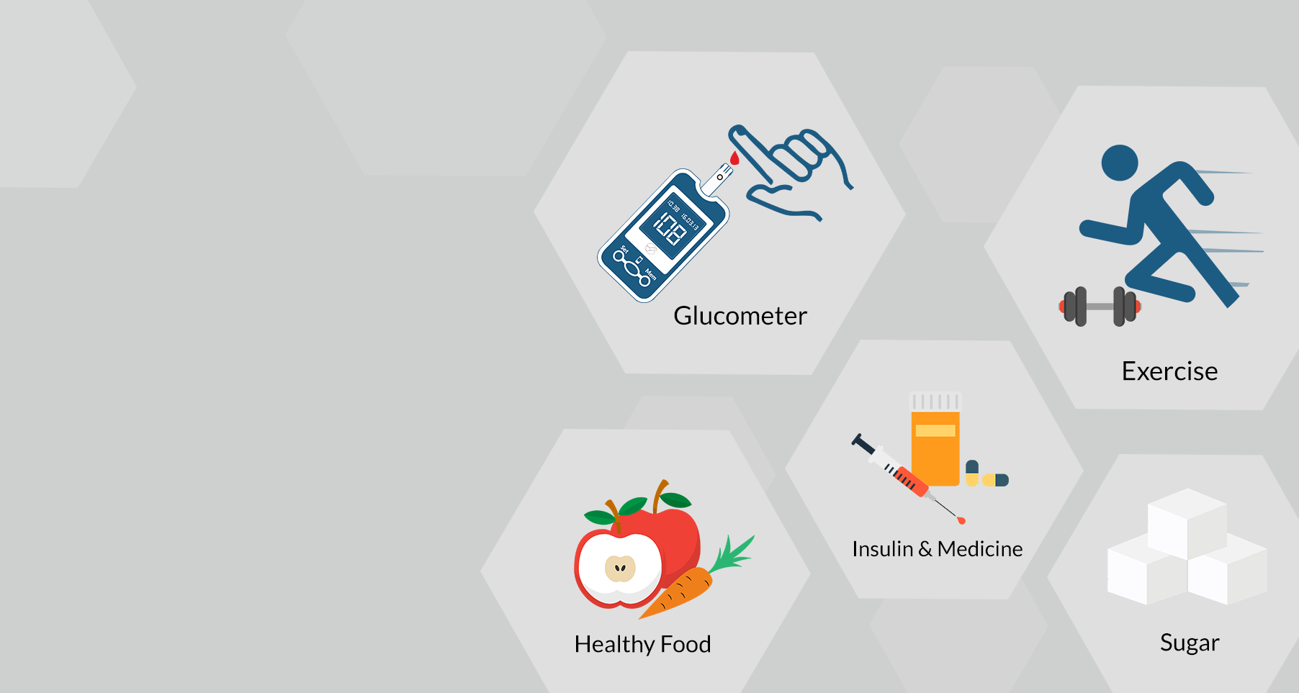
“DiaBeta” Intelligent, Secured Smart App for Complete Diabetes Lifestyle Management

Slide 2

What is diabetes?
Diabetes is a long-term illness that affects the way your body turns food into energy.
Types of diabetes.
Type 1
Type 2
Gestational diabetes (diabetes while pregnant)

Slide 3
Introduction
Why Diabetes Management is important?
Diabetics are at a higher risk of developing ailments such as heart disease, renal disease, stroke, vision problems, nerve damage etc.
People with better diabetes control, may expect to live active, independent, and vigorous lives.
Diabetes management requires awareness.
What is DiaBeta?
DiaBeta is an Intelligent, Secured Smart App for Complete Diabetes Lifestyle Management.

Slide 4

Research Question
Diabetes is a lifelong illness.
There's no cure for type 2 diabetes.
So, prevention and control are essential.
Effective lifestyle management takes awareness, education, and consideration.

Slide 5

Main Objective
Develop an intelligent, secure smart mobile application for complete diabetes lifestyle management

Slide 6
Sub Objectives
Predict Diabetes
Recommend Diets and Exercise Plans
Identify Health Risk
SpO2, Heart Rate, Glucose Level Monitoring

Slide 7
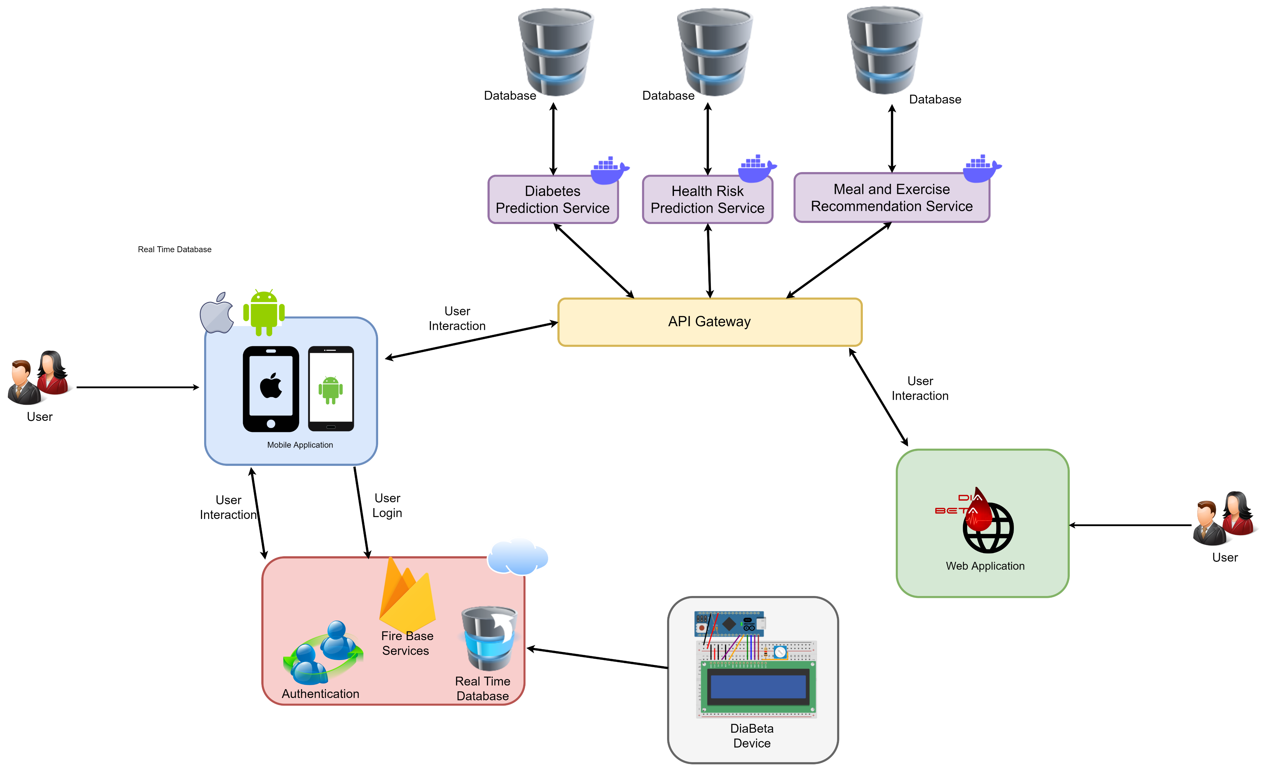
System Diagram

Slide 8
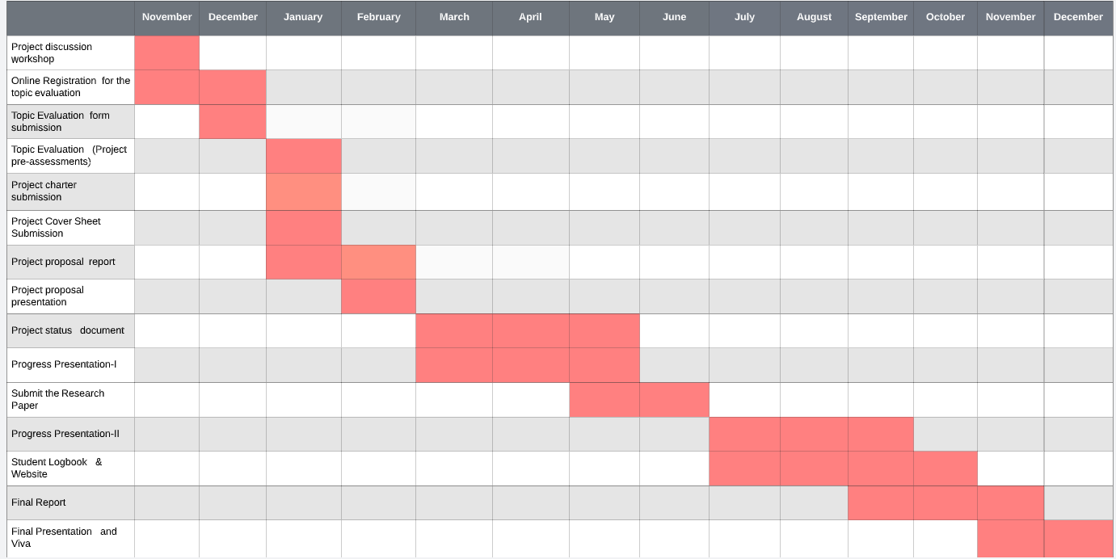
Grant Chart

Slide 9
Research Gap
 | Diabetes Prediction | Recommended Diet plans | Recommended Exercises | Identify Heart, Eye, Kidney risks. | Automated Data input for glucose monitoring. | Digital logbook | Summary view through charts and graphs. | Diabetes Education | Keeping patient data secure | Generate questionaries and analyze answers. | Blood pleasure monitoring | Keep Track of daily exercises
Diabetes: M | ❌ | ✅ | ❌ | ❌ | ❌ | ✅ | ✅ | ✅ | ✅ | ✅ | ✅ | ❌
Glucose Buddy | ❌ | ❌ | ❌ | ❌ | ❌ | ✅ | ✅ | ❌ | ✅ | ❌ | ✅ | ❌
mySugr | ❌ | ❌ | ❌ | ❌ | ✅ | ✅ | ✅ | ❌ | ✅ | ❌ | ✅ | ✅
Intelin | ❌ | ❌ | ❌ | ✅ | ✅ | ✅ | ✅ | ❌ | ✅ | ✅ | ✅ | ✅
DiaBeta | ✅ | ✅ | ✅ | ✅ | ✅ | ✅ | ✅ | ✅ | ✅ | ✅ | ✅ | ✅

Slide 10

Predicting diabetes and keep track of user’s data Jayasekara J.T.N.N IT19115894
SE

Slide 11
Research Gap
 | Diabetes Prediction | Provide intelligent reminders and recommendations | Generate methods to educate the community | Summary view through charts and graphs. | Add, update, delete users daily glucose, insulin, pills information
Diabetes: M | ❌ | ✅ | ✅ | ✅ | ✅
Glucose Buddy | ❌ | ❌ | ❌ | ✅ | ✅
mySugr | ❌ | ❌ | ❌ | ✅ | ✅
Intelin | ❌ | ❌ | ✅ | ✅ | ✅
DiaBeta | ✅ | ✅ | ✅ | ✅ | ✅

Slide 12

Research Question
Diabetes is becoming more prevalent in people's daily lives.
Diabetes often have no symptoms at first.
Prediction of diabetes is important.
Diabetes patient having intelligent reminders about time to take medicine, clinic dates and other important facts is also helpful.

Slide 13
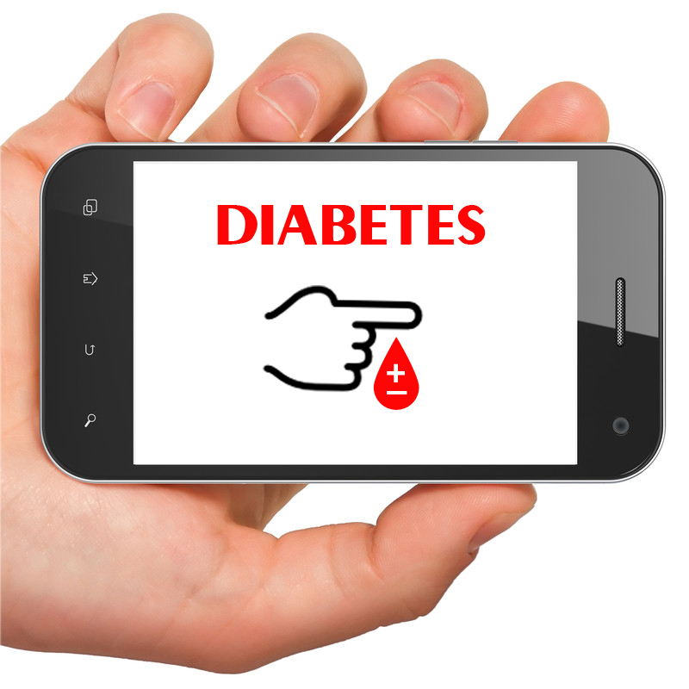
Specific and Sub Objectives
Predicts diabetes using a mobile application.
Generates a questionnaire to gather necessary information from the user and analyse answers.
Provide ability to add, update, delete users' daily glucose, insulin, pills information and generate reports.
Give reminders and recommendations.

Slide 14

Methodology
Data Analysis
Exploratory data analysis
Model Building: Build 4 ML models and select best performing one.
Saving Model: Saving the best model to make the prediction from real data

Slide 15
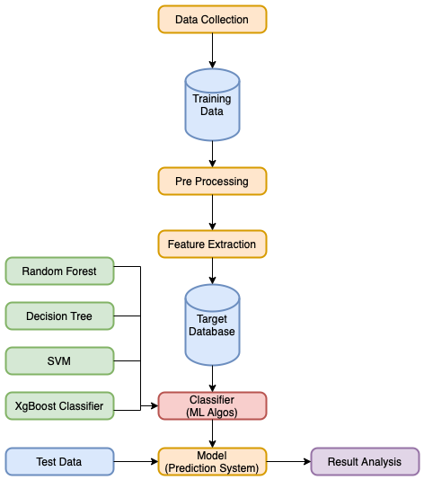
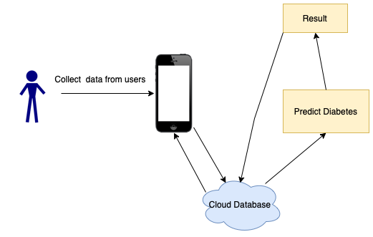
System Diagram

Slide 16




Algorithms And Technologies
Algorithms
Random Forest
Decision Tree
Support Vector Machine
XgBoost Classifier
Technologies
Machine Learning
Phyton
Flutter
NodeJS
Firebase

Slide 17
Requirements
Reliability
Non-Functional Requirements
Availability
Performance
Requirements
System Requirements
Android 8.0 or higher

Slide 18
Outcomes
Predict user’s diabetes accurately using ML algorithms
Provide
intelligent reminders and recommendations
Generate reports from user’s diabetes data
Generate method to educate the community (Questionnaire, video etc)

Slide 19

Recommend Diet Plan and Exercise
R.H. Gunasekera
IT19184272
SE

Slide 20
Background
How does diet and exercises affect diabetes?
What are the factors considering to create diet and exercise plan?
- fasting blood sugar level.
- blood pressure.
- BMI.
- body composition assessment.
- required calorie count per day.
- calorie count of diets.
- calorie burn count of exercises.

Slide 21
Research Gap
 | Recommended Diet plans | Recommended Exercises | Digital logbook | Diabetes Education
Diabetes: M | ✅ | ❌ | ✅ | ✅
Glucose Buddy | ❌ | ❌ | ✅ | ❌
mySugr | ❌ | ❌ | ✅ | ❌
DiaBeta | ✅ | ✅ | ✅ | ✅

Slide 22
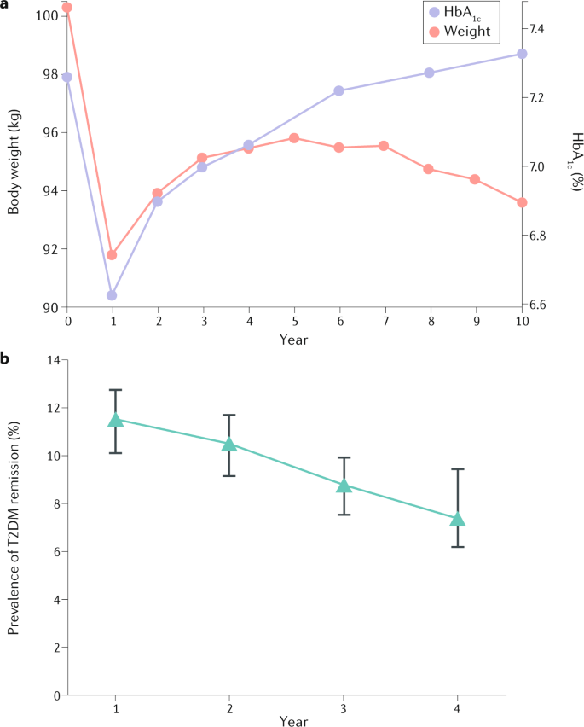
Research Problem
Can people reverse their type 2 diabetes condition with diet and exercise?
How to generate personalized diet plan in accordance with required calorie?
How to generate personalized exercises in accordance with blood glucose level and body composition assessment?

Slide 23

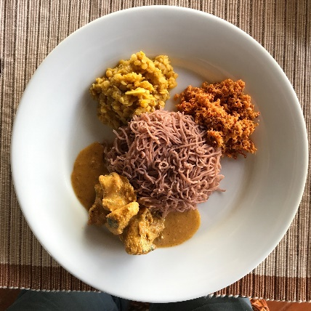
Specific and Sub Objectives
Analyzing body composition assessment.
Entry of calculated calorie count of local cuisines and matching along.
Entry of exercises and matching along with analyzed body endurance.

Slide 24
Methodology
Collect necessary information from users
Data Analysis
Train Models using various algorithms.
Mapping the data with predefined rule into the algorithm
Recommended healthy diet and workout plans

Slide 25
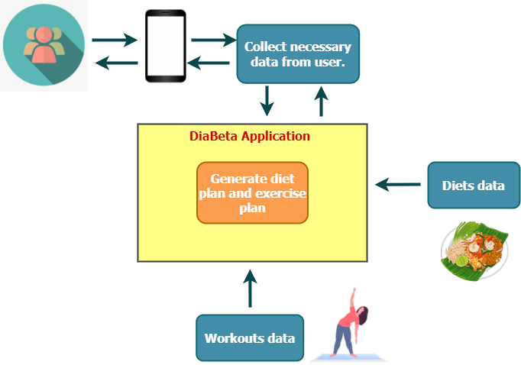
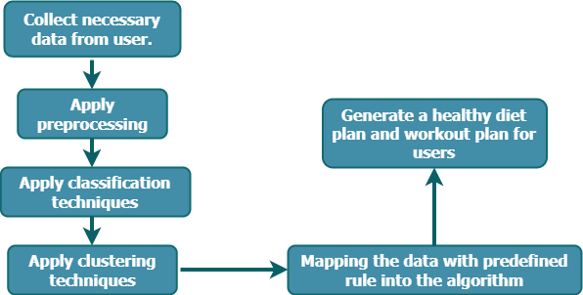
System Diagram

Slide 26
Algorithms And Technologies
Algorithms
Random Forest
Decision Tree
Support Vector Machine
Technologies
Machine Learning
Phyton
Flutter
NodeJS
Firebase

Slide 27
Requirements
Reliability
Non-Functional Requirements
Availability
Performance
Requirements
System Requirements
Android 8.0 or higher

Slide 28
Outcomes
Recommended Personalized Diet Plan
Recommended Personalized Exercise Plan
User friendly & easy to use the mobile app.

Slide 29

Identify Health Risk
Ravindu Hasanka V.G. IT19156798

Slide 30
Research Gap
 | Identify Heart, Eye, Kidney risks. | Diabetes Education | Keeping patient data secure | Generate questionaries and analyze answers.
Diabetes: M | ❌ | ✅ | ✅ | ✅
Glucose Buddy | ❌ | ❌ | ✅ | ❌
mySugr | ❌ | ❌ | ✅ | ❌
Intelin | ✅ | ❌ | ✅ | ✅
DiaBeta | ✅ | ✅ | ✅ | ✅

Slide 31

Research Question
As people's standard of living rises, diabetes becomes more prevalent in their daily lives.
People with diabetes are often at risk for health risks.
Therefore, the potential health risk of diabetes is important, and it would be very useful if the user could use a mobile app to identify the potential health risk of their diabetes.

Slide 32
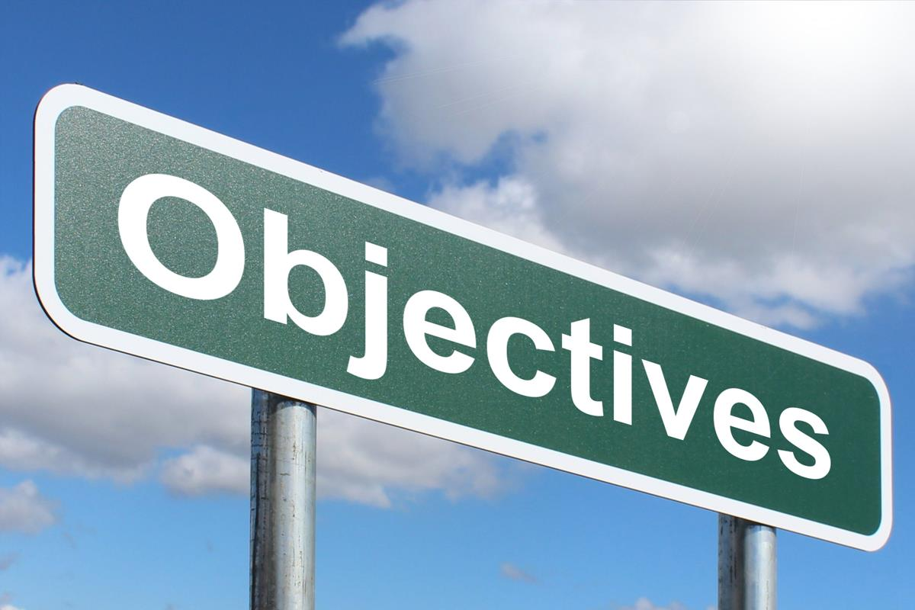
Objectives
Using a mobile app makes it easy to identify the health risks of diabetes.
Generates a questionnaire to gather the required information from the user and to analyze the answers in the questionnaire.
Prevent risk of Health.
Handle the automating algorithm
This Photo by Unknown Author is licensed under CC BY-SA

Slide 33
Methodology
The dataset was randomly partitioned into training set and testing set using train.
Models are trained using various algorithms using entire training set.
Data is fed into each trained model to measure model performance.
Identify which organ has the highest health risk in current status.

Slide 34
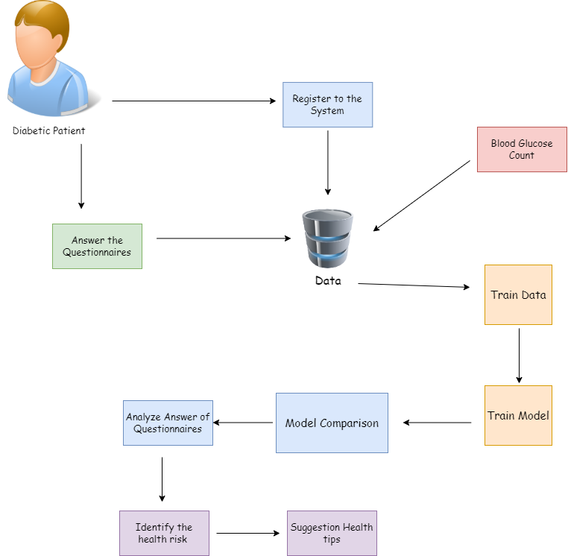
Design Diagram

Slide 35
Algorithms And Technologies
Algorithms
Random Forest
Decision Tree
Support Vector Machine
Technologies
Machine Learning
Phyton
Flutter
NodeJS
Firebase

Slide 36
Requirements
Reliability
Non-Functional Requirements
Availability
Performance
Requirements
System Requirements
Android 8.0 or higher

Slide 37
Outcomes
Preparation of a questionnaire distributed to the public regarding the acquisition of knowledge on diabetes
Identify which organ has the highest health risk in current status.
Enhance the reliability.
User friendly & easy to use the mobile app.

Slide 38

SpO2, Heart Rate, Glucose Level Monitoring
Hasintha Kashmika H.B.G IT19115962
CSNE

Slide 39
Research Question
Current devices that measure heart rate, devices that measure blood oxygen levels, and devices that measure blood glucose are expensive.
Also, measuring blood glucose by hand puncture is commonly seen as an invasive approach. Some people are reluctant to pierce their hands and measure their blood glucose levels.
The solution is to activate a monitoring system using a Node MCU to measure the heart rate of the human body, directly connecting sensors to blood oxygen levels, and measuring blood glucose as a non-invasive approach.
The device that measures heart rate, blood oxygen level, and blood glucose levels connect to the Firebase real-time database via Wi-fi

Slide 40
Research Gap
Features | Advanced Social Internet of Things for Real-Time Monitoring of Diabetics Patient in Healthcare System | IoT-based personal health care monitoring device for diabetic patients | Non-Invasive Blood Glucose Level Monitoring Using IoT | “DiaBeta” App
Measure the Blood Glucose level | YES | NO | YES | YES
Measure the Heart rate | YES | NO | YES | YES
Measure the Blood Oxygen level | NO | NO | NO | YES
Connect to the Mobile Application via Wi-fi | NO | NO | NO | YES
Implement the portable device to easily moved around | YES | YES | NO | YES

Slide 41
Objectives
To establish a blood Oxygen level and heart rate monitoring system
To establish a non-invasive blood glucose monitoring system
Connecting the device to the Firebase real time database via Wi-fi
Implement the portable device to easily moved around

Slide 42
Methodology
A sensor is connected to the Node MCU to measure heart rate and measure blood oxygen levels.
Glucose is projected to obtain the depth of penetration required to monitor glucose levels by absorbing light using the NIR spectroscopy as a non-invasive method.
CJMCU aims to obtain blood glucose levels using the OPT-11 photodiode.
It aims to transmit a device that measures heart rate, blood oxygen level and blood glucose levels to the Node MCU and connect Wi-Fi to the DiaBeta Mobile app via it.
In addition, the Arduino LCD is expected to show heart rate, blood oxygen levels, and blood glucose levels.

Slide 43
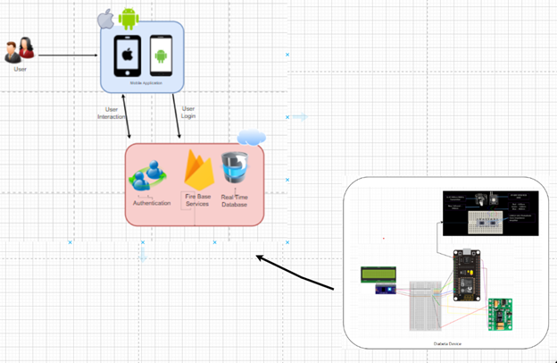
Design Diagram

Slide 44
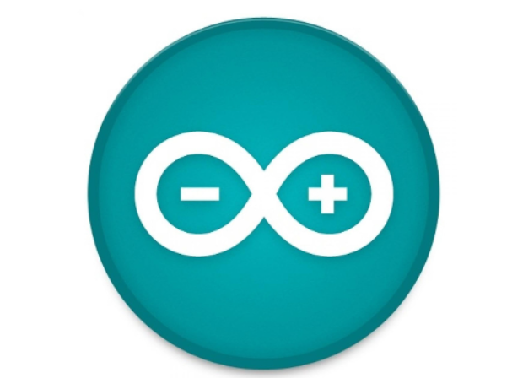
Technologies and Tools
Technologies
Firebase
Arduino C
Tools
Arduino IDE

Slide 45
Requirements
Reliability
Non-Functional Requirements
Availability
Performance
Requirements
System Requirements
Android 8.0 or higher

Slide 46
Outcomes
Measuring Blood Oxygen level
Measuring Heart Rate
Measuring Blood Glucose level

Slide 47
References
[1] Bandara, S., 2021. talkingeconomics - Beat Diabetes in Sri Lanka: Too Much Sugar is Not that Sweet. [online] Ips.lk. Available at: <https://www.ips.lk/talkingeconomics/2016/04/07/beat-diabetes-in-sri-lanka-too-much-sugar-is-not-that-sweet/> [Accessed 16 December 2021].
[2] Callahan, A., Bedosky, L. and Kacy Church, M., 2021. 16 Best Diabetes Apps to Try in 2021. [online] EverydayHealth.com. Available at: <https://www.everydayhealth.com/hs/type-2-diabetes-care/diabetes-apps/> [Accessed 16 December 2021].
[3] H. Ahmed, E. M. G. Younis, and A. A. Ali, “Predicting Diabetes using Distributed Machine Learning based on Apache Spark,” IEEE Xplore, Feb. 01, 2020. https://ieeexplore.ieee.org/document/9047795 (accessed Dec. 16, 2021).
[4] R. Y. Toledo, A. A. Alzahrani, and L. Martínez, “A Food Recommender System Considering Nutritional Information and User Preferences,” IEEE Access, vol. 7, pp. 96695–96711, 2019, doi: 10.1109/ACCESS.2019.2929413.
[5]S. Ananthi and V. Bhuvaneswari, “Prediction of heart and kidney risks in diabetic prone population using fuzzy classification,” IEEE Xplore, Jan. 01, 2017. https://ieeexplore.ieee.org/document/8117713 (accessed Dec. 16, 2021).
[6] G. Usic, “Development of a Patient-Specific Model for Patients with Diabetes Type I Using Meal and Exercise Guidelines from Modern Schools of Diabetes,” IEEE Xplore, Oct. 01, 2020. https://ieeexplore.ieee.org/document/9280228 (accessed Dec. 16, 2021).
[7] A. B. Reddy, A. K. Sai, and A. Sivasangari, “Non-Invasive Blood Glucose Level Monitoring Using IoT,” IEEE Xplore, Jun. 01, 2020. https://ieeexplore.ieee.org/document/9142887(accessed Dec. 16, 2021).
[8]“MAX30100 Pulse Oximeter with ESP8266 on Blynk IoT App,” How To Electronics, Jan. 12, 2020. https://how2electronics.com/max30100-pulse-oximeter-with-esp8266/(accessed Dec. 16, 2021).
‌

